Slide 1
Manufacturing Task Tracker
Report Generation

Slide 2
What to enter in MTT reports to get print out of LIFE tasks
HTTP://TASKTRACKER
Click on Reports button on top menu bar
Select Task Item Listing Report
Select sort option (Facility/Due Date or Responsible Person/Due Date
**Selection criteria to choose for LIFE project:
Facility: Prattville
Business Unit: Millwide
Area/Department: Safety
Type: Health&Safety
**These selections will select all tasks that fall into these categories, but currently the only ones that exist are the LIFE tasks.
We will be adding more selection criteria to the report screen to select only LIFE project in the near future. You will get tasks
for +/- 20 yrs if you do not select any date ranges.
Click on Display Report
(See screen example on next page)

Slide 3
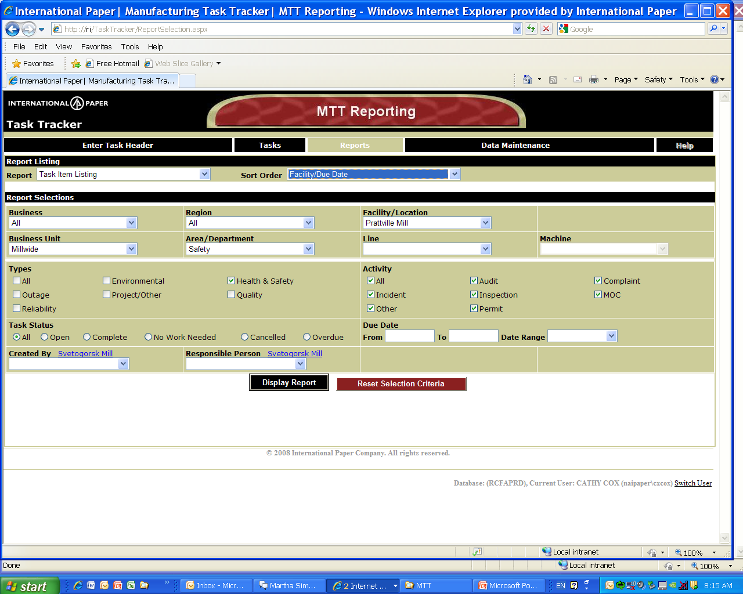

Slide 4
The report will be displayed in Crystal Reports
To scroll pages: Select right or left Yellow arrows on Crystal toolbar
To print pages: Click on Printer Icon on Crystal toolbar
To export pages to another format (pdf, excel,etc) : Click on envelope icon on Crystal toolbar
(Report example on next page)

Slide 5
